Slide 1

Precipitation prediction
Dor sandler
Rotem balter
Roni admon

Slide 6
CASPNET
Sara Sabour, Nicholas Frosst, Geoffrey E Hinton. Dynamic Routing Between Capsules. NIPS 2017
Xifeng Guo - https://github.com/XifengGuo/CapsNet-Keras

Slide 7
CASPNET
Originally trained on MNIST, detecting multiple classes
Motivation: pattern recognition
Key feature – Routing by agreement
Notes:
2 digits in the same picture

Slide 8
Coordinate frame
Geometrical aspects like position, scale, rotation
In math terms it is a vector, and the relation between them is a transformation matrix
We then can preserve position and pose data which is very important for meteorologic predictions

Slide 9
Capsules
Usually in a Neural Network we care about the existence of the pattern, but in order to know how it exists we use a concept called capsules
We call a group of neuron a capsule and refer to the relation between them – coordinate frames gather to a vector, and an object is made from several parts and it only exist if all the parts exist in the proper manner

Slide 10
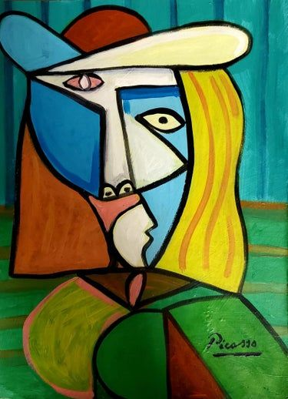
Picasso problem
When ignoring the position of element making a specific object,
We can identify a human face even if it’s parts doesn’t align
Routing by agreement method is a possible solution
Notes:
In a regular neural network we can have the
Like in a Picasso painting

Slide 11
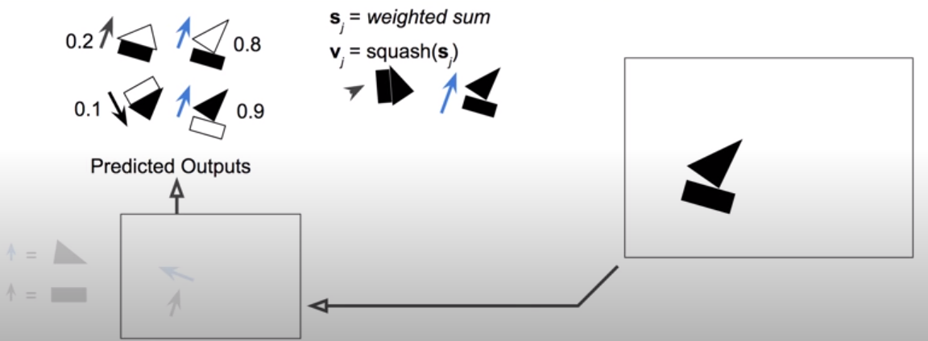
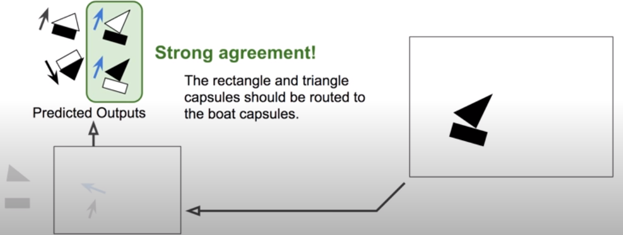
Routing by agreement
Summing the vectors – low level capsules
Finding clusters of agreement and routing only them to higher level capsules that agrees with them
We used 3 routing iteration
Notes:
Take for example this picture on the right which is complexed from a triangle and a rectangle , and let say we classify for a house or a boat, so we have 2 higher capsules
Each capsule not only predicts whether the object exists, it also predicts its properties
each capsule separately tries to predict the whole object’s properties, thus also the properties for the other parts
(for the boat capsule, the triangle will expect the rectangle to be underneath it with a gap, and for the house it will expect it to be as close to it same for the other capsules)
Summing the capsules vectors – low level capsules and if they correlate with each other the sum vector will be bigger than for capsules which don’t correlate
We then make new prediction, we did this phase for 3 times, and that’s how we find the clusters of agreement

Slide 12
Non-linearity
It is especially used for models where we have to predict the probability as an output
We want to predict the probability of relations of the different level capsules

Slide 13
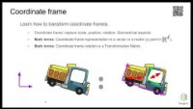

Slide 14
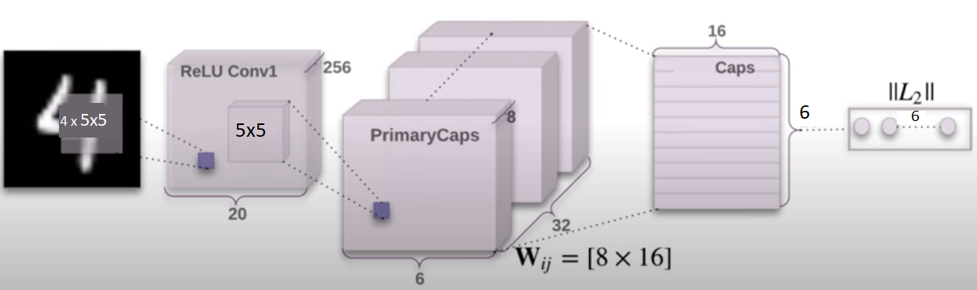
Classical capsnet Starts as fully connected
Notes:
4*5*5 is our data size
First goes through a regular convolutional layer
then the output goes to each from the 32 primary capsule – low level capsules
Each will output a 8 dimension vector - then using the routing iterations
So each lower capsule decides to which higher capsule it sends it’s data to – each lower capsule will have few higher capsule parent, not all of them
The higher level capsules is the size of 16*6 – 6 rain categories, our classes , 16 is the attribute vectors for each level, which includes data like rotation/width/position and other parameters
As the parameters in the vector are more aligned with each other for the existence of this particular object, the sum of these vectors will be larger therefore capsule is more likely to be chosen

Slide 15
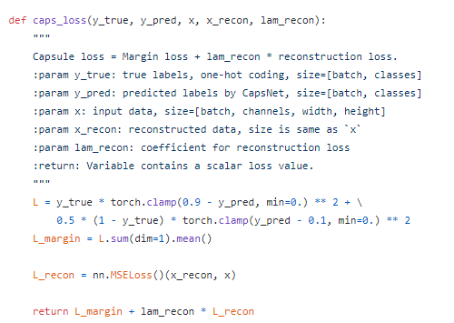
Loss function
To allow multiple classes (MNIST digits) capsnet uses separate margin loss for each class capsule
Total loss is simply the sum of the losses of all class’s capsules
Notes:
Identifying 2 digits

Slide 16
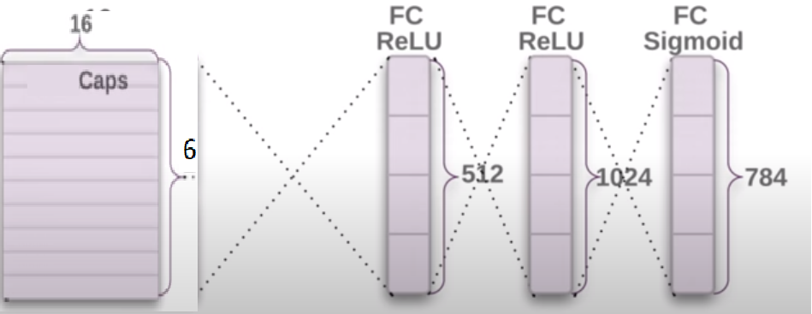
Decoder
Very small use of it but it makes the difference
Feedback loop to keep spatial
comparing the input object to the reconstructed object with MSELoss
Notes:
Small use – scale down to 0.0005 so it won’t be too dominant
makes the difference – in the paper they showed the results on MNIST with and without the decoder were very different
Makes the high level caps to encode some kind of information about the original image
We didn’t look at the reconstructed images but did use the decoder loss

Slide 17
Pros // Cons
Requires less training data
Routing by agreement is great for overlapping
Position and pose data are preserved
Activations nicely map hierarchy of parts
Cannot see 2 identical very close objects (crowding)
Routing by agreement inner loop makes slow training

